Slide 1
Software Design Principles
SOLID & More
learnwithtiemoon.com/professional-oop

Slide 2

Software design
principles represent a set of guidelines that helps us to avoid having a bad design
learnwithtiemoon.com/professional-oop

Slide 3
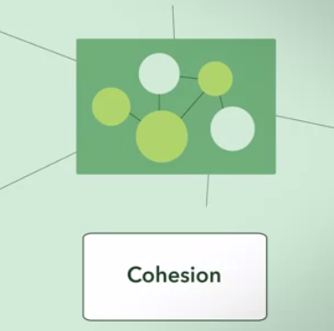
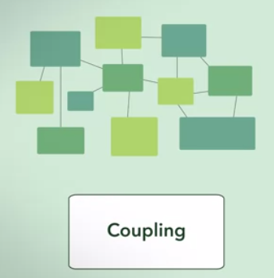
Abstract Design Guideline
Cohesion: Degree of togetherness between modules/classes/attributes.
Related code should be close to each other
Bind all related code together as close as possible.
Coupling: Degree of dependency between the different modules/classes.
Modules/Classes should be independent as far as possible.
learnwithtiemoon.com/professional-oop

Slide 4

Art of Unix Programming
Rule of Clarity: Clarity is better than cleverness.
Rule of Composition: Design programs to be connected to other programs.
Rule of Separation: Separate policy from mechanism; separate interfaces from engines
Rule of Simplicity: Design for simplicity; add complexity only where you must
learnwithtiemoon.com/professional-oop

Slide 5
Art of Unix Programming (Cont’d)
Rule of Transparency: Design for visibility to make inspection and debugging easier
Rule of Robustness: Robustness is the child of transparency and simplicity
Rule of Least Surprise: In interface design, always do the least surprising thing
Rule of Silence: When a program has nothing surprising to say, it should say nothing
learnwithtiemoon.com/professional-oop

Slide 6
Art of Unix Programming (Cont’d)
Rule of Repair: When you must fail, fail noisily and as soon as possible
Rule of Economy: Programmer time is expensive; conserve it in preference to machine time
Rule of Optimization: Prototype before polishing. Get it working before you optimize it.
Rule of Extensibility: Design for the future, because it will be here sooner than you think
Source : http://www.catb.org/esr/writings/taoup/html/ch01s06.html
learnwithtiemoon.com/professional-oop

Slide 7

Symptoms of Rotting Design
Rigidity
Fragility
Immobility
Viscosity
learnwithtiemoon.com/professional-oop

Slide 8

Rigidity
Difficult to change
Ripple Effect
Entering roach motel
A software can be called a rigid when it is difficult to change even in a sample way
When the manager’s fears become so acute that they refuse to allow changes to software, official rigidity sets in. Thus, what starts as a design deficiency, winds up being adverse management policy.
learnwithtiemoon.com/professional-oop

Slide 9

Fragility
Conceptually irrelevant pieces breaking in multiple places
Such software is impossible to maintain. Every fix makes it worse, introducing more problems than are solved
Managers and Customers have a feeling that Developers have lost control over the project
Closely related to rigidity is fragility. Fragility is the tendency of the software to break in many places every time it is changed. Often the breakage occurs in areas that have no conceptual relationship with the area that was changed
learnwithtiemoon.com/professional-oop

Slide 10

Immobility
Inability to reuse software
Software is simply rewritten instead of reused
Immobility is the inability to reuse software from other projects or from parts of the same project. It often happens that one engineer will discover that he needs a module that is similar to one that another engineer wrote
I am asking for someone NOT everyone
learnwithtiemoon.com/professional-oop

Slide 11

Viscosity
It is easy to do the wrong thing, but hard to do the right thing
When the design preserving methods are harder to employ than the hacks, then the viscosity of the design is high
Viscosity of environment comes about when the development environment is slow and inefficient
learnwithtiemoon.com/professional-oop

Slide 12
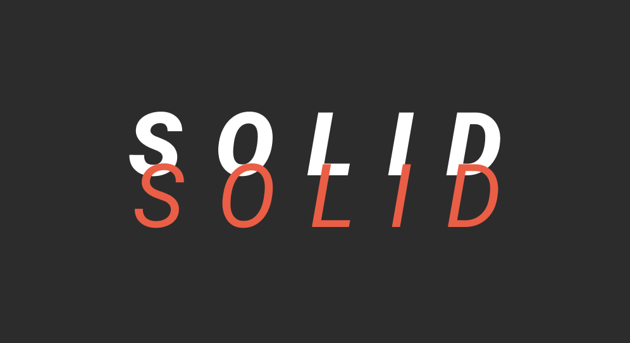
learnwithtiemoon.com/professional-oop

Slide 13
SOLID & More….
Tell Don’t Ask
DRY – Don’t Repeat yourself
Once and only once
The Law of Demeter
Package Principles
DRY
YAGNI
Single Responsibility Principle (SRP)
Open Closed Principle (OCP)
Liskov Substitution Principle (LSP)
Interface Segregation Principle (ISP)
Dependency Inversion Principle (DIP)
learnwithtiemoon.com/professional-oop

Slide 14

Single Responsibility Principle (SRP)
There should never be more than one reason for a class to change.
learnwithtiemoon.com/professional-oop

Slide 15
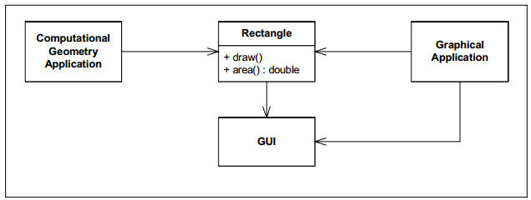
SRP (Cont’d)
Rectangle class will change for two reasons
learnwithtiemoon.com/professional-oop

Slide 16
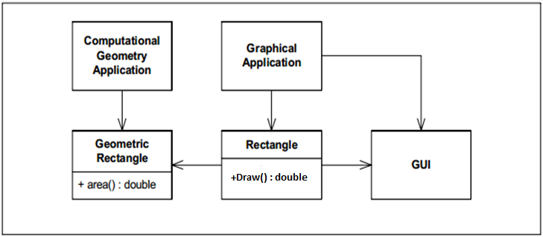

SRP (Cont’d)
learnwithtiemoon.com/professional-oop

Slide 17
SRP (Cont’d)
class User
{
void CreatePost(Database db, string postMessage)
{
try
{
db.Add(postMessage);
}
catch (Exception ex)
{
db.LogError("An error occured: ", ex.ToString());
File.WriteAllText("\LocalErrors.txt", ex.ToString());
}
}
}
learnwithtiemoon.com/professional-oop
Notes:
https://itnext.io/solid-principles-explanation-and-examples-715b975dcad4

Slide 18
SRP (Cont’d)
class User
{
private ErrorLogger errorLogger = new ErrorLogger();
void CreatePost(Database db, string postMessage)
{
try
{
db.Add(postMessage);
}
catch (Exception ex)
{
errorLogger.Log(ex.ToString());
}
}
}
class ErrorLogger
{
void Log(Database db, string error)
{
db.LogError("An error occured: ", error);
File.WriteAllText("\LocalErrors.txt", error);
}
}
learnwithtiemoon.com/professional-oop
Notes:
https://itnext.io/solid-principles-explanation-and-examples-715b975dcad4

Slide 19
Practice 17: Applying SRP
In the provided code, the OnDemandAgentService class violates the Single Responsibility Principle (SRP) by handling multiple responsibilities.
By refactoring, please ensure that each class is focused on a single responsibility, making the system more maintainable, testable, and scalable.
Code link
learnwithtiemoon.com/professional-oop
Notes:
https://itnext.io/solid-principles-explanation-and-examples-715b975dcad4

Slide 20
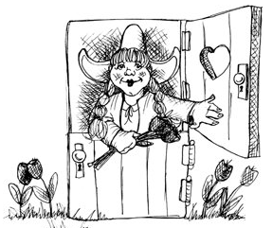
Open Closed Principle (OCP)
A module should be open for extension but closed for modification
learnwithtiemoon.com/professional-oop

Slide 21
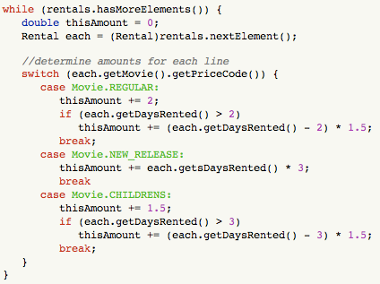
OCP (Cont’d)
OCP violation
learnwithtiemoon.com/professional-oop

Slide 22
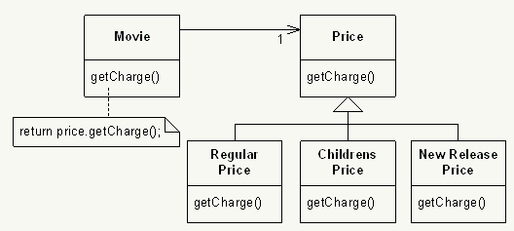
OCP (Cont’d)
learnwithtiemoon.com/professional-oop

Slide 23
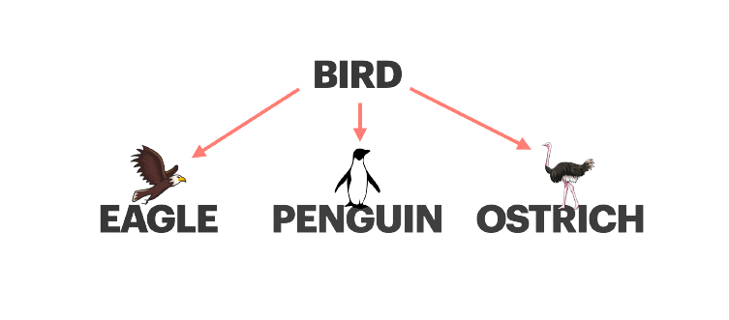
Liskov Substitution Principle (LSP)
Subclasses should be substitutable for their base classes.
LSP Violation
learnwithtiemoon.com/professional-oop

Slide 24
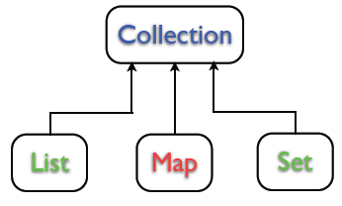
LSP (Cont’d)
learnwithtiemoon.com/professional-oop

Slide 25
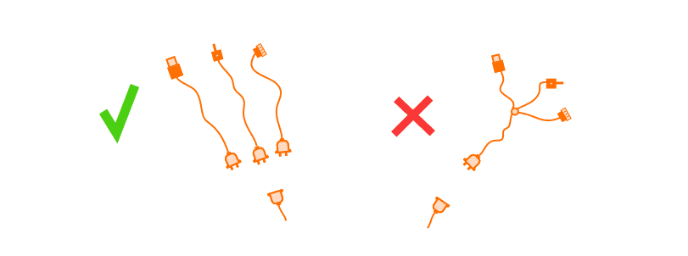
Interface Segregation Principle (ISP)
Many client specific interfaces are better than one general purpose interface
learnwithtiemoon.com/professional-oop

Slide 26
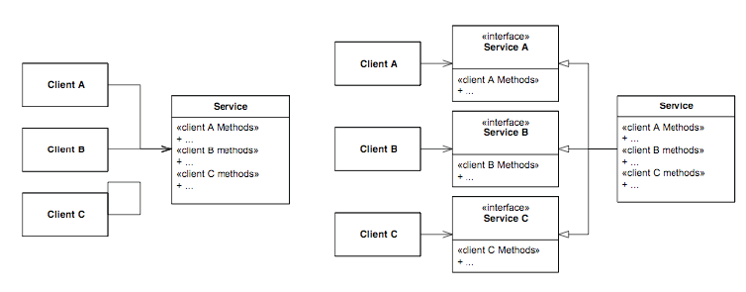
ISP (Cont’d)
learnwithtiemoon.com/professional-oop

Slide 27
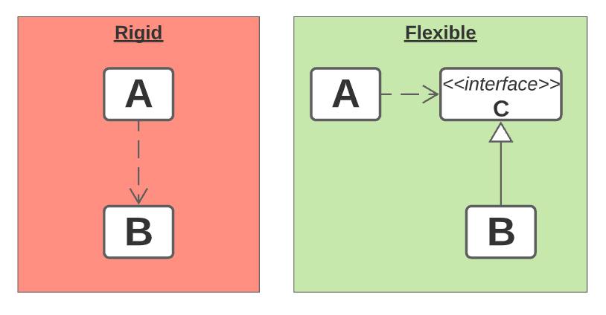
Dependency Inversion Principle (DIP)
Depend upon Abstractions. Do not depend upon concretions
learnwithtiemoon.com/professional-oop
Notes:
https://www.codeproject.com/Articles/615139/An-Absolute-Beginners-Tutorial-on-Dependency-Inver

Slide 28
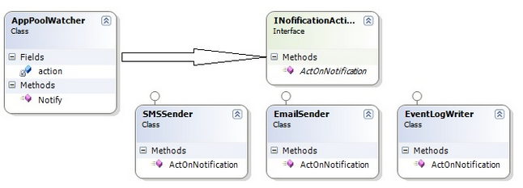
DIP (Cont’d)
learnwithtiemoon.com/professional-oop

Slide 29
Practice 18: Applying DIP
Payment Processing System
In today's digital commerce, customers use various payment methods to complete transactions. A well-designed payment processing system should handle different payment methods such as Credit Card, bKash, PayPal, and Bank Transfer, ensuring scalability to integrate future payment methods seamlessly.
Your task is to design a system that adheres to the Dependency Inversion Principle (DIP), allowing the high-level PaymentService module to remain independent of specific payment method implementations.
learnwithtiemoon.com/professional-oop

Slide 30

Tell Don’t Ask
learnwithtiemoon.com/professional-oop

Slide 31
Tell Don’t Ask (Cont’d)
if(getStateOfSomething())
doThis();
else
doThat();
V/S
object.doSomethingForMe();
learnwithtiemoon.com/professional-oop

Slide 32
DRY – Don’t Repeat yourself
Every piece of knowledge must have a single, unambiguous, authoritative representation within a system
Practice -19: Download this code and refactor it using DRY principle
Refactoring has as a primary objective getting each piece of functionality to exist in exactly one place in the software. –Ron Jeffries
Once and only once
learnwithtiemoon.com/professional-oop

Slide 33
The Law of Demeter
Any method of an object should only call methods belonging to:
itself
any composite objects
any parameters that were passed in to the method
any objects it created
learnwithtiemoon.com/professional-oop

Slide 34
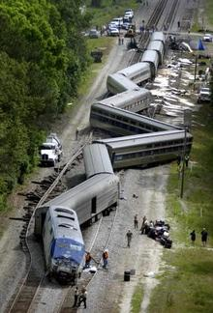
Train Wreck
Methods belonging to objects that were returned from some other call.
my_television.front_panel.switches.power.on();
v/s
my_television.power_up();
Talk only to your neighbors, not with their neighbors.
learnwithtiemoon.com/professional-oop

Slide 35
Train Wreck
What is the problem here?
Deep Chaining: order.Customer.Address.Street and order.Customer.Address.City traverse multiple levels of objects, forming a "train wreck."
  Reduced readability
  Increased Fragility
  Makes Testing Harder
Tight Coupling: The OrderProcessor class is tightly coupled to the internal structure of Order, Customer, and Address. Any change to these structures will ripple through the code.
Encapsulation Violation: The Order and Customer classes expose too much of their internal details, reducing encapsulation.
learnwithtiemoon.com/professional-oop

Slide 36

YAGNI (You ain’t gonna need it)
What If…..
"Always implement things when you actually need them, never when you just foresee that you need them.” – Ron Jeffries
The need for combining it with the supporting practices, rather than using it standalone
learnwithtiemoon.com/professional-oop

Slide 37
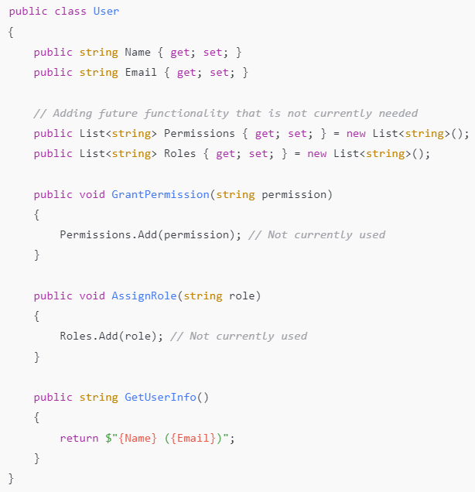
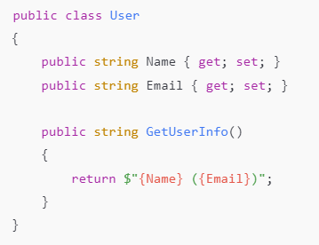
YAGNI (You ain’t gonna need it)
learnwithtiemoon.com/professional-oop

Slide 38
YAGNI (You ain’t gonna need it)
Why YAGNI…
Cost of Building - Wrong features
Cost of Delay - If you work for the next Sprints, you will fail this Sprint
Cost of Carry - Build wrong and carry it
Cost of Repair - Build wrong and repair overtime
learnwithtiemoon.com/professional-oop

Slide 39
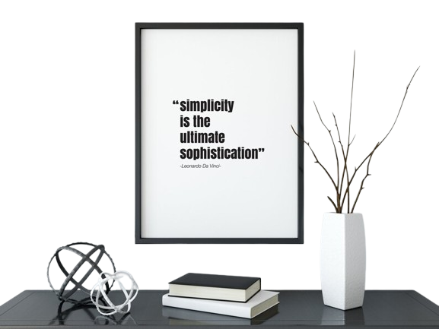
KISS (Keep It Simple & Stupid)
“Any intelligent fool can make things bigger, more complex, and more violent. It takes a touch of genius—and a lot of courage to move in the opposite direction”
- E. F. Schumacher
learnwithtiemoon.com/professional-oop

